Slide 1
Other Relational Languages
Tuple Relational Calculus
Domain Relational Calculus

Slide 2
Tuple Relational Calculus
A nonprocedural query language, where each query is of the form
{t | P (t ) }
It is the set of all tuples t such that predicate P is true for t
t is a tuple variable, t [A ] denotes the value of tuple t on attribute A
t ∈ r denotes that tuple t is in relation r
P is a formula similar to that of the predicate calculus

Slide 3
Predicate Calculus Formula
1. Set of attributes and constants
2. Set of comparison operators: (e.g., <, ≤, =, ≠, >, ≥)
3. Set of connectives: and (∧), or (v)‚ not (¬)
4. Implication (⇒): x ⇒ y, if x if true, then y is true
x ⇒ y ≡ ¬x v y
5. Set of quantifiers:
  ∃ t ∈ r (Q (t )) ≡ ”there exists” a tuple in t in relation r
  such that predicate Q (t ) is true
  ∀t ∈ r (Q (t )) ≡ Q is true “for all” tuples t in relation r

Slide 4
Banking Example
branch (branch_name, branch_city, assets )
customer (customer_name, customer_street, customer_city )
account (account_number, branch_name, balance )
loan (loan_number, branch_name, amount )
depositor (customer_name, account_number )
borrower (customer_name, loan_number )

Slide 5
Example Queries
Find the loan_number, branch_name, and amount for loans of over $1200
{t | t ∈ loan ∧ t [amount ] > 1200}
Suppose that we want only the loan-number attribute, rather than all attributes of the
loan relation. To write this query in the tuple relational calculus, we need to write
an expression for a relation on the schema (loan-number).
Find the loan number for each loan of an amount greater than $1200
{t | ∃ s ∈ loan (t [loan_number ] = s [loan_number ] ∧ s [amount ] > 1200)}
Notice that a relation on schema [loan_number ] is implicitly defined by
the query

Slide 6
Example Queries
Find the names of all customers having a loan, an account, or both at the bank
{t | ∃s ∈ borrower ( t [customer_name ] = s [customer_name ])
∨ ∃u ∈ depositor ( t [customer_name ] = u [customer_name ])
Find the names of all customers who have a loan and an account
at the bank
{t | ∃s ∈ borrower ( t [customer_name ] = s [customer_name ])
∧ ∃u ∈ depositor ( t [customer_name ] = u [customer_name] )

Slide 7
Example Queries
Find the names of all customers having a loan at the Perryridge branch
{t | ∃s ∈ borrower (t [customer_name ] = s [customer_name ]
∧ ∃u ∈ loan (u [branch_name ] = “Perryridge”
∧ u [loan_number ] = s [loan_number ]))}
Find the names of all customers who have a loan at the
Perryridge branch, but no account at any branch of the bank
{t | ∃s ∈ borrower (t [customer_name ] = s [customer_name ]
∧ ∃u ∈ loan (u [branch_name ] = “Perryridge”
∧ u [loan_number ] = s [loan_number ]))
∧ not ∃v ∈ depositor (v [customer_name ] =
t [customer_name ])}

Slide 8

Example Queries
“Find all customers who have an account at the bank but do not have a loan from the bank.
Find the names of all customers having a loan from the Perryridge branch, and the cities in which they live
{t | ∃s ∈ loan (s [branch_name ] = “Perryridge”
∧ ∃u ∈ borrower (u [loan_number ] = s [loan_number ]
∧ t [customer_name ] = u [customer_name ])
∧ ∃ v ∈ customer (u [customer_name ] = v [customer_name ]
∧ t [customer_city ] = v [customer_city ])))}

Slide 9
Example Queries
Find the names of all customers who have an account at all branches located in Brooklyn:
{t | ∃ r ∈ customer (t [customer_name ] = r [customer_name ]) ∧
( ∀ u ∈ branch (u [branch_city ] = “Brooklyn” ⇒
∃ s ∈ depositor (t [customer_name ] = s [customer_name ]
∧ ∃ w ∈ account ( w[account_number ] = s [account_number ]
∧ ( w [branch_name ] = u [branch_name ]))))}

Slide 10
Safety of Expressions
It is possible to write tuple calculus expressions that generate infinite relations.
For example, { t | ¬ t ∈ r } results in an infinite relation if the domain of any attribute of relation r is infinite
To guard against the problem, we restrict the set of allowable expressions to safe expressions.
An expression {t | P (t )} in the tuple relational calculus is safe if every component of t appears in one of the relations, tuples, or constants that appear in P
  NOTE: this is more than just a syntax condition.
    E.g. { t | t [A] = 5 ∨ true } is not safe --- it defines an infinite set with attribute values that do not appear in any relation or tuples or constants in P.

Slide 11
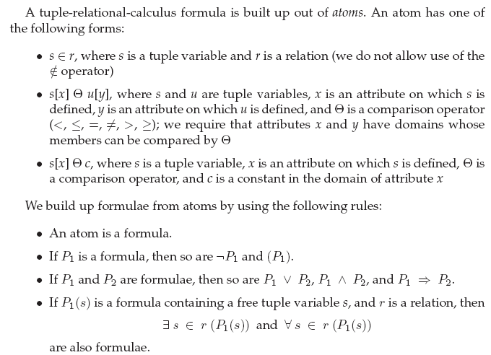

Slide 12

In the tuple relational calculus, equivalences include the following three rules:

Slide 13
Domain Relational Calculus
A second form of relational calculus, called domain relational calculus, uses domain variables that take on values from an attributes domain, rather than values for an entire tuple.
A nonprocedural query language equivalent in power to the tuple relational calculus
Each query is an expression of the form:
{ < x₁, x₂, …, x_{n} > | P (x₁, x₂, …, x_{n})}
where x1, x2, . . . , xn represent domain variables. P represents a formula composed of atoms. An atom in the domain relational calculus has one of the following forms:
< x1, x2, . . . , xn > ∈ r, where r is a relation on n attributes and x1, x2, . . . , xn are domain variables or domain constants.

Slide 14
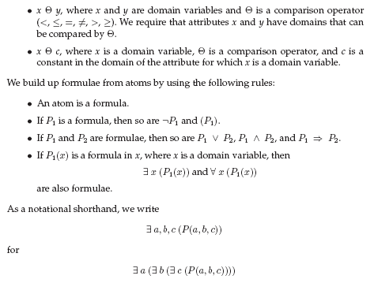

Slide 15
Example Queries
Find the loan_number, branch_name, and amount for loans of over $1200
{< l, b, a > | < l, b, a > ∈ loan ∧ a > 1200}
Find the names of all customers who have a loan from the Perryridge branch and the loan amount:
  {< c, a > | ∃ l (< c, l > ∈ borrower ∧ ∃b (< l, b, a > ∈ loan ∧
b = “Perryridge”))}
  {< c, a > | ∃ l (< c, l > ∈ borrower ∧ < l, “ Perryridge”, a > ∈ loan)}
branch (branch_name, branch_city, assets )
customer (customer_name, customer_street, customer_city )
account (account_number, branch_name, balance )
loan (loan_number, branch_name, amount )
depositor (customer_name, account_number )
borrower (customer_name, loan_number )

Slide 16
Example Queries
Find the names of all customers having a loan, an account, or both at the Perryridge branch:
{< c > | ∃ l ( < c, l > ∈ borrower
∧ ∃ b,a (< l, b, a > ∈ loan ∧ b = “Perryridge”))
∨ ∃ a (< c, a > ∈ depositor
∧ ∃ b,n (< a, b, n > ∈ account ∧ b = “Perryridge”))}
Find the names of all customers who have an account at all
branches located in Brooklyn:
{< c > | ∃ s,n (< c, s, n > ∈ customer) ∧
∀ x,y,z (< x, y, z > ∈ branch ∧ y = “Brooklyn”) ⇒
∃ a,b (< x, y, z > ∈ account ∧ < c,a > ∈ depositor)}
branch (branch_name, branch_city, assets )
customer (customer_name, customer_street, customer_city )
account (account_number, branch_name, balance )
loan (loan_number, branch_name, amount )
depositor (customer_name, account_number )
borrower (customer_name, loan_number )

Slide 17
Safety of Expressions
The expression:
{ < x₁, x₂, …, x_{n} > | P (x₁, x₂, …, x_{n} )}
is safe if all of the following hold:
All values that appear in tuples of the expression are values from dom (P ) (that is, the values appear either in P or in a tuple of a relation mentioned in P ).
For every “there exists” subformula of the form ∃ x (P₁(x )), the subformula is true if and only if there is a value of x in dom (P₁) such that P₁(x ) is true.
For every “for all” subformula of the form ∀_{x} (P₁ (x )), the subformula is true if and only if P₁(x ) is true for all values x from dom (P₁).

